Slide 1

Fish & Accessories Store System
Author: Hrikesh Aran

Slide 2
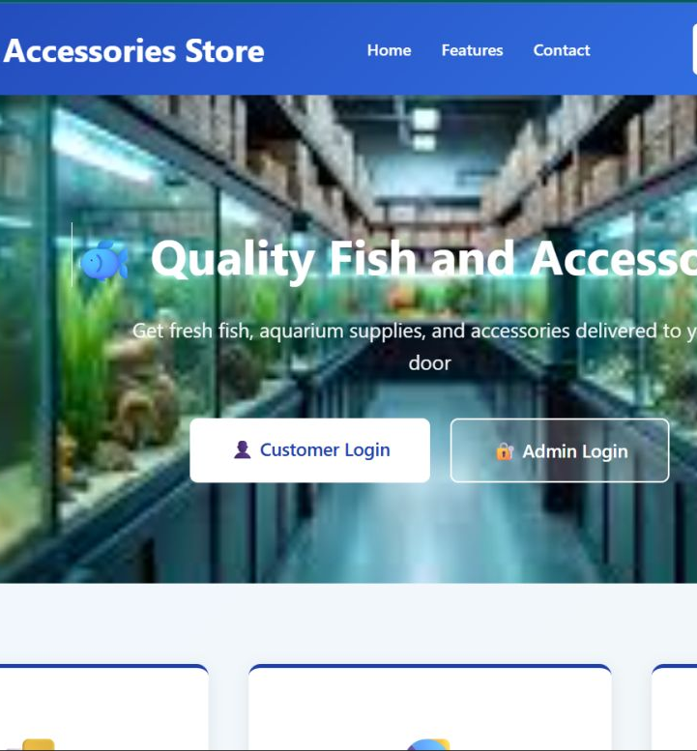
CONTENTS
Introduction
Problem Statement
Objectives
System Architecture and Diagrams
Key Features
Admin Dashboard Capabilities
Conclusion
Future Implementation

Slide 3
Introduction
Online platform for fish and aquarium product shopping
Allows users to browse and purchase products online
Provides secure user account and order management
Admin dashboard for managing products and inventory
Built using PHP and MySQL
Uses responsive frontend and efficient backend system

Slide 4
3. Problem Statement
Store owners face challenges such as:
Inventory Management
Managing inventory manually.
Customer Reach
Limited reach to customers.
Record-keeping
Lack of digital record-keeping.
Customers, on the other hand:
Product Comparison
Cannot easily compare products.
Online Access
Have no access to online purchasing.
Convenience
Face inconvenience in visiting stores.

Slide 5
Objectives
The main objective of the Fish & Accessories Store System is to provide a user-friendly online platform for buying fish and related products.
Specific Objectives include:
Product Browsing
Allow users to browse fish and accessories with detailed descriptions.
User Registration
Enable user registration and secure login.
Online Ordering
Provide an online ordering and checkout system.
Admin Dashboard
Develop an admin dashboard for product management.
Data Management
Store and manage data using a MySQL database.
Responsive Design
Ensure responsive design for different devices.
User Experience
Improve customer experience through an intuitive interface.

Slide 6
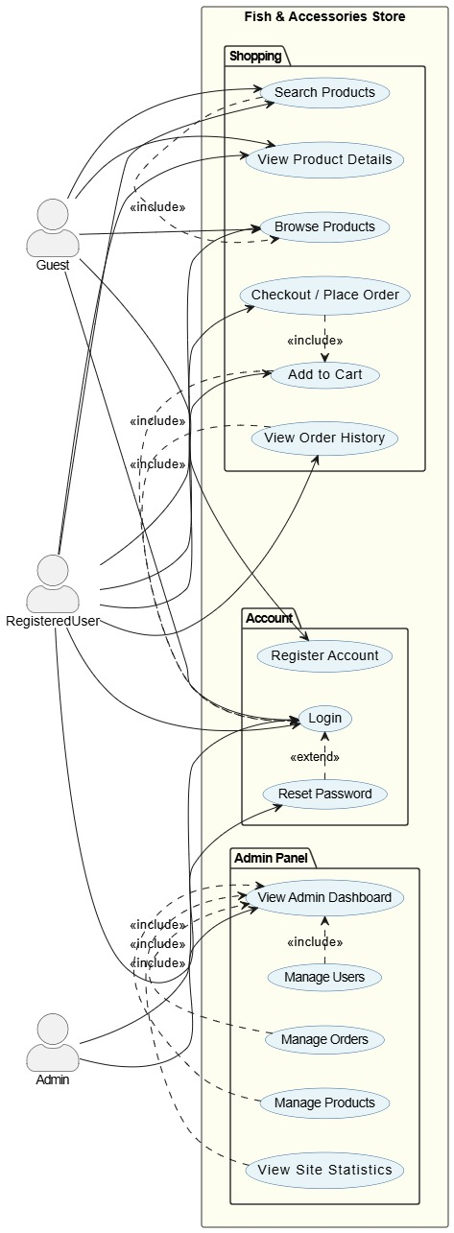
5. System Architecture and Diagrams
System has three actors: Guest, Registered User, and Administrator
Guest can browse, search, and view product details
Registered User can:
  Register and log in
  Add products to cart
  Checkout and place orders
  View order history
Administrator can:
  Access admin dashboard
  Manage users, products, and orders
  View site statistics
Checkout requires Add to Cart functionality
Reset Password extends the login process
Admin features are restricted to authorized administrators only

Slide 7
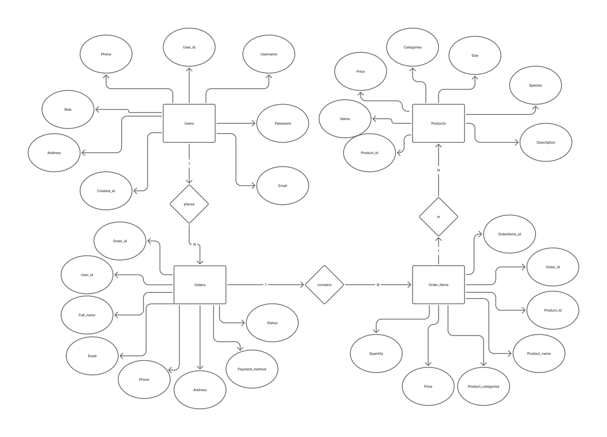
Entity-Relationship Diagram
The Entity-Relationship diagram shows four primary entities and their relationships:
USER
  Stores customer and admin information
  Includes login, contact, and role details
PRODUCT
  Contains fish and accessory product details
  Includes price, category, size, and description
ORDER
  Stores customer order information
  Includes payment method and order status
ORDER_ITEMS
  Contains products included in each order
  Stores quantity and price details
Relationships
  One user can place multiple orders
  One order can contain multiple products
  Products can appear in many order items

Slide 8
6. Key Features
Product Search & Browsing
Users can search and browse fish and aquarium accessories.
Shopping Cart & Checkout
Add products to cart and complete purchase transactions.
Order Management
Track order status and order history.
Admin Product Management
Add, update, and delete products.
Site Statistics Dashboard
View registered users, total orders, and system metrics.
User Authentication
Secure login and registration system.
Responsive Interface
User-friendly design across different devices.

Slide 9

Admin Dashboard Capabilities
The admin dashboard provides full control panel for store management with the following capabilities:
User Management
View registered user count and manage user accounts.
Order Tracking
Browse all orders in descending date order with customer details and click any order to load itemized products via AJAX.
Product Control
Add new products with name, category, price, quantity, and image URL; delete products instantly with confirmation prompt.
Status Updates
Update order status transitions from Pending to Processing to Shipped to Delivered.
Dashboard Overview
View total user registrations and total orders at a glance.
Role Protection
Role-protected dashboard that redirects non-admins back to

Slide 10
Conclusion
The Fish & Accessories Store System successfully provides a digital solution for managing and purchasing aquarium products. It simplifies the shopping process for customers and enhances store management for administrators.
The system demonstrates key web development concepts, including database integration, session management, and dynamic content rendering. Its modular structure allows for easy maintenance and scalability.
Overall, the project serves as a practical implementation of an e-commerce platform and can be further developed into a full-scale commercial application.

Slide 11

Future Implementation
Proposed future enhancements for the Fish and Accessories Store system include:
Online Payment Integration
Integration with online payment systems such as eSewa, Khalti, and credit cards.
Real-time Tracking
Real-time order tracking capability.
Customer Feedback
Customer reviews and ratings functionality.
Advanced Search
Advanced search and filtering options.
Mobile Application
Mobile application development for iOS and Android.
Notifications
Email and SMS notifications for order updates.
Enhanced Security
Improved security measures including password hashing and input validation.
AI Recommendations
AI-based product recommendations for users.

Slide 12
Thank you!

